Slide 1
Start-up
6.25.24 version 1.0

Slide 2
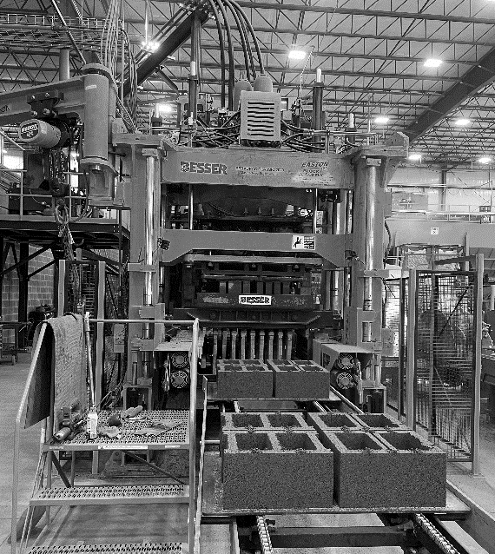
Assumptions and Prerequisite Skills
The computer is on and IntelliBatch 3.0 is open
The proper closing procedures were completed the night before
The power switch is on (HMI screen is on)
Supplies Needed
Standard PPE Equipment
Mallet

Slide 3
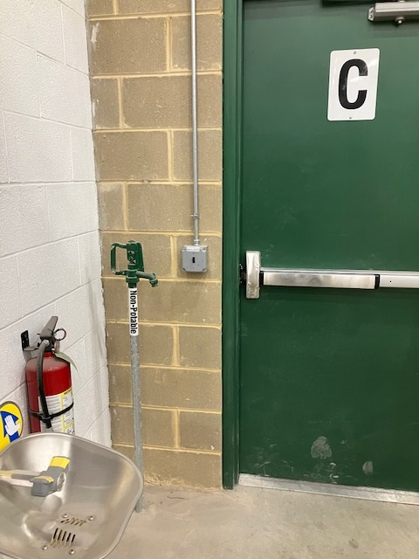
Procedure
1. Turn on the lights by door C (Figure 1)
Figure 1

Slide 4
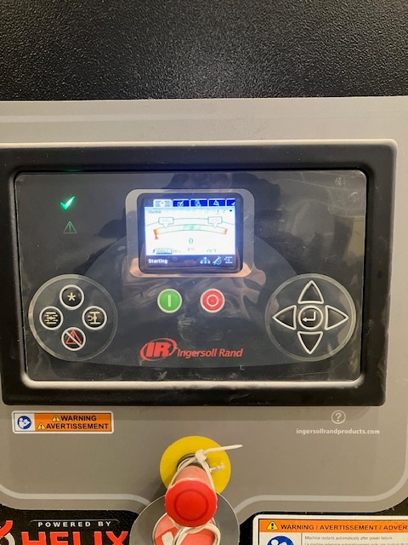
Procedure
2. To the left of the kiln room door, you will find the air compressor. Push the green button, and check to see if a green checkmark lights up (Figure 2)
Figure 2

Slide 5
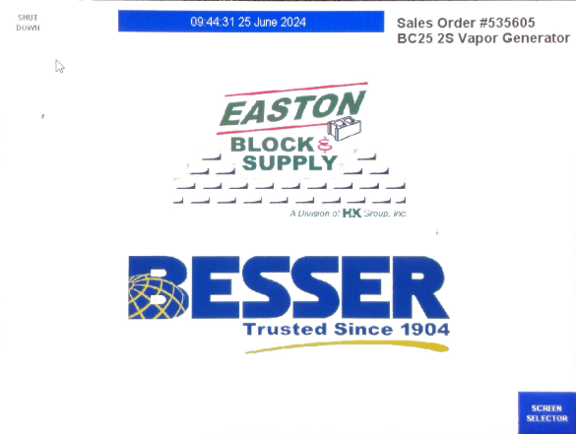
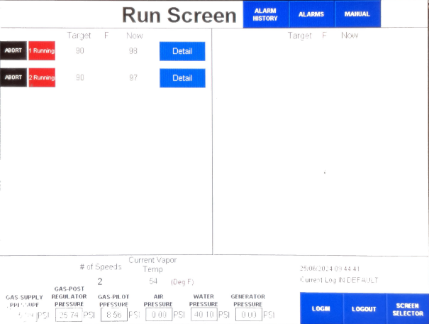
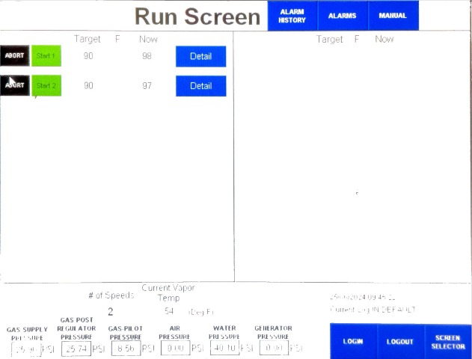
Procedure
Figure 3A
3. Right by the air compressor, you will find a door that says “Vapor Generator”. Enter that room and check if the power light (green light) is on. If it isn’t twist and pull out the emergency stop button and press the “reset” button (Figure 3A).
4. Click on the “Run Screen” button. Make sure both rows read “Running” (Figure 3B).
Figure 3B Running
Figure 3C Not Running

Slide 6
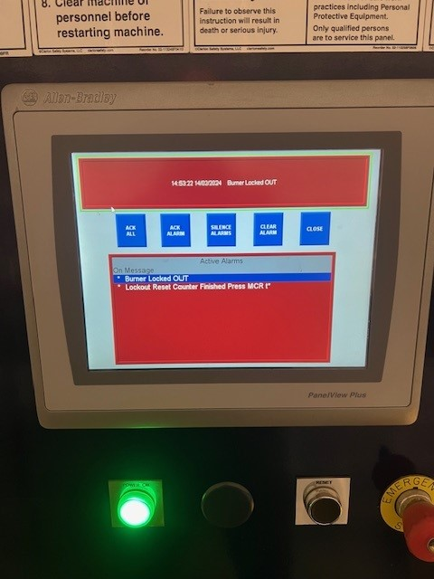
Procedure
5. If the alarm screen for the generator is showing: Press the “ACK Alarm” to acknowledge the alarm, press “Close” and then press “Reset” (Figure 4)
Figure 4

Slide 7
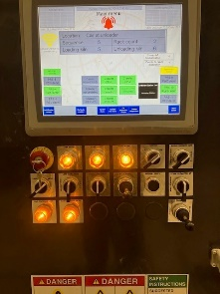
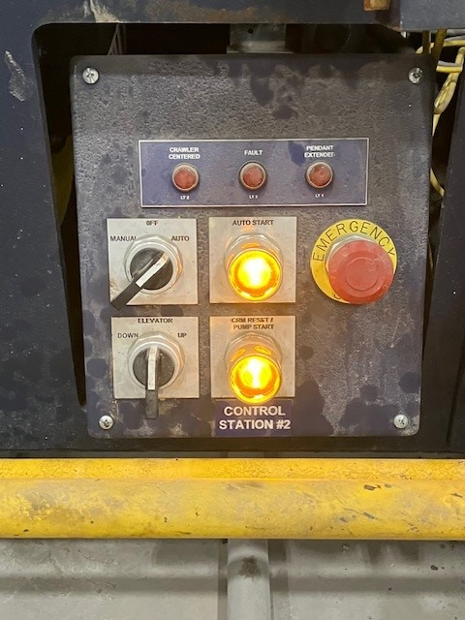
Procedure
Proceed to the car/platform. For the car, press the “CRM reset” button, followed by the “Pump Start” button, and then the “Auto Start” button (Figure 5A)
For the crawler, press the “CRM Reset/Pump Start” button, followed by the “Auto Start” button (Figure 5B)
Figure 5A Should look like this
Figure 5B. Should look like this

Slide 8
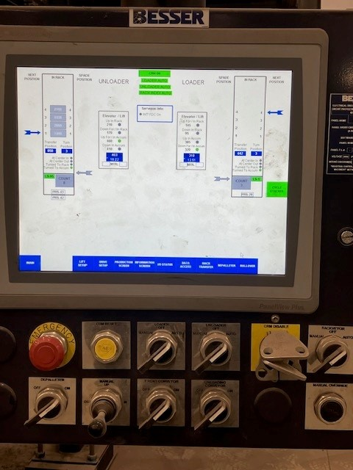
Procedure
8. Report to the Bessermatic monitor. Twist and pull out the emergency stop button and press the “CRM Reset” button (Figure 6)
Figure 6

Slide 9
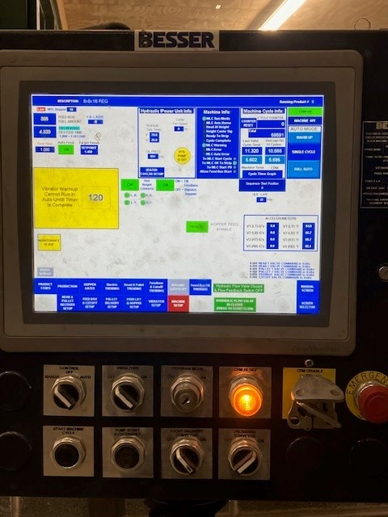
Procedure
9. Proceed to the Besser HMI. Twist and pull out the emergency stop button and press the “CRM reset" button (Yellow arrow in Figure 7), followed by the “Pump Start Auto” button (Red arrow in Figure 7)
Figure 7

Slide 10
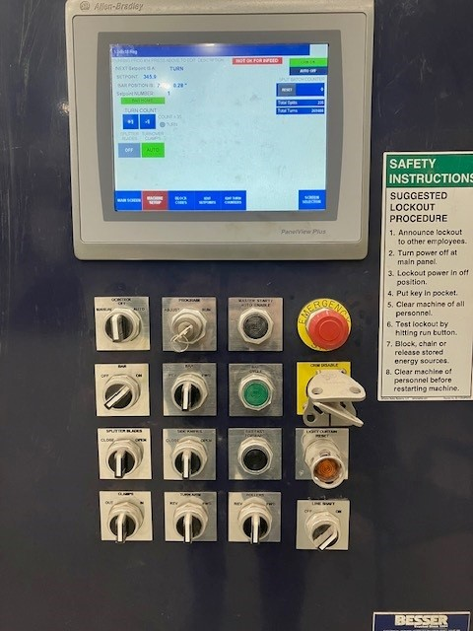
Procedure
10. Go to the Depalleter. Twist and pull the out the emergency stop button and press the “master start/auto enable” button (Red arrow Figure 8)
Figure 8

Slide 11
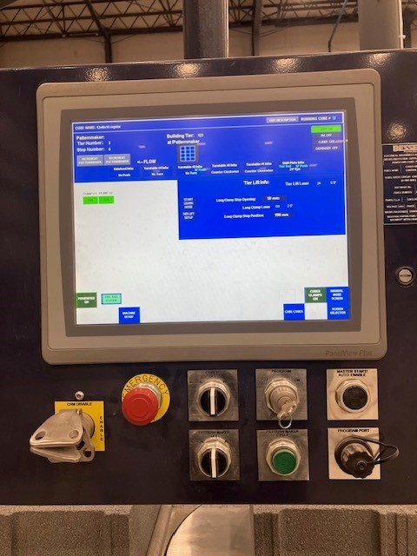
Procedure
11. Proceed to the cuber. Twist and pull out the emergency stop button and press the “Master Start/Auto Enable” button (Red arrow in Figure 9)
Figure 9

Slide 12
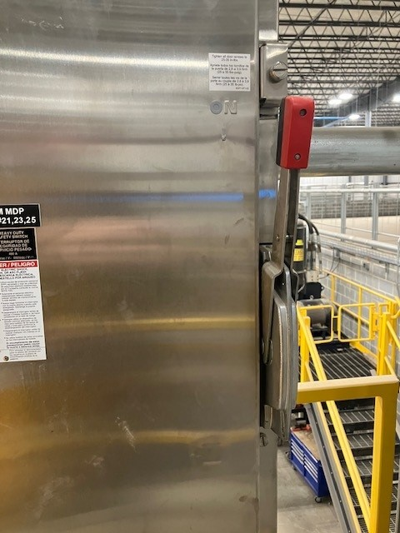
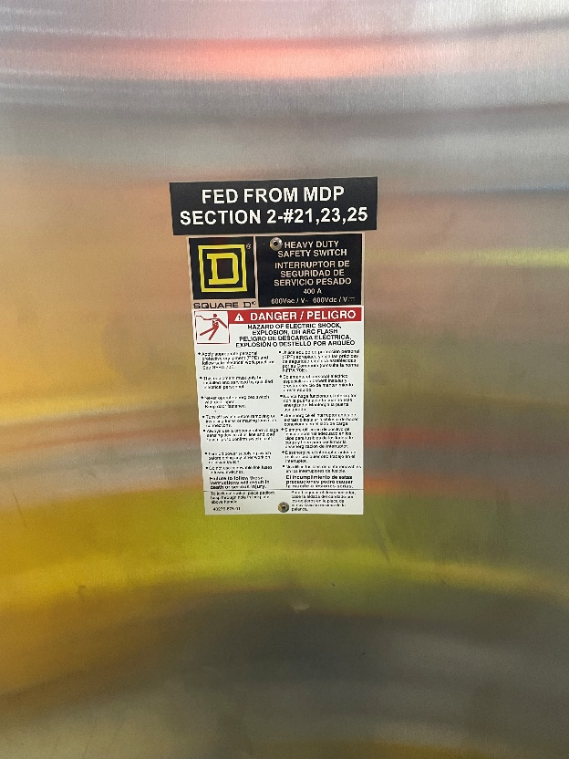
Procedure
12. Go up the first flight of steps and walk straight ahead. Pull up on the disconnect handle (Yellow arrow in Figure 10). Be sure to push up with force
Figure 10. Should look like this

Slide 13
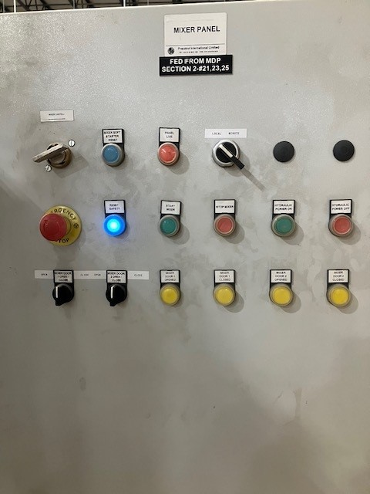
Procedure
13. Twist and pull out the emergency stop button and push the “Reset Safety” blue button (Red arrow in Figure 11)
Figure 11

Slide 14
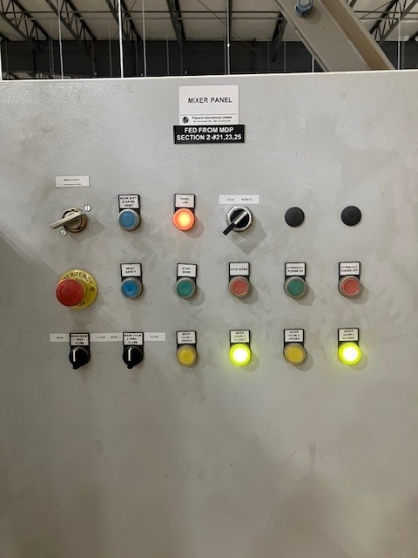
Procedure
14. Press the “Hydraulic Power On” button (Yellow arrow in Figure 12)
15. Wait about 2 minutes and then hold the switch to the close position (Red arrow in Figure 12) on the “Mixer door 2 open/close” switch until the door/gate is fully closed
Figure 12

Slide 15
Procedure
16. Turn the Local/Remote switch to remote (Yellow arrow in Figure 13)
Figure 13

Slide 16
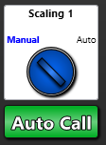
Procedure
17. Set scaling to manual on the “Main View” page of IntelliBatch (Figure 14)
Figure 14

Slide 17
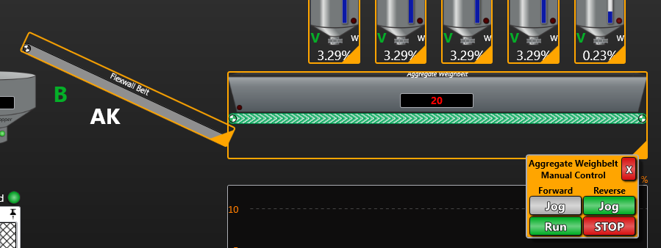
Procedure
18. Find the Aggregate Weighbelt icon on the top-right side of the page. Click on the orange triangle in the bottom right corner and click “Run” under reverse. This dumps out any potential debris that hardened up overnight (Yellow circle in Figure 15)
Figure 15. Notice how the belt is already running in reverse. The “Run” button would be under the Jog button

Slide 18
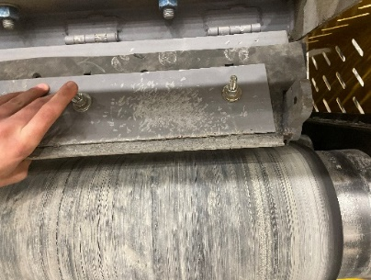
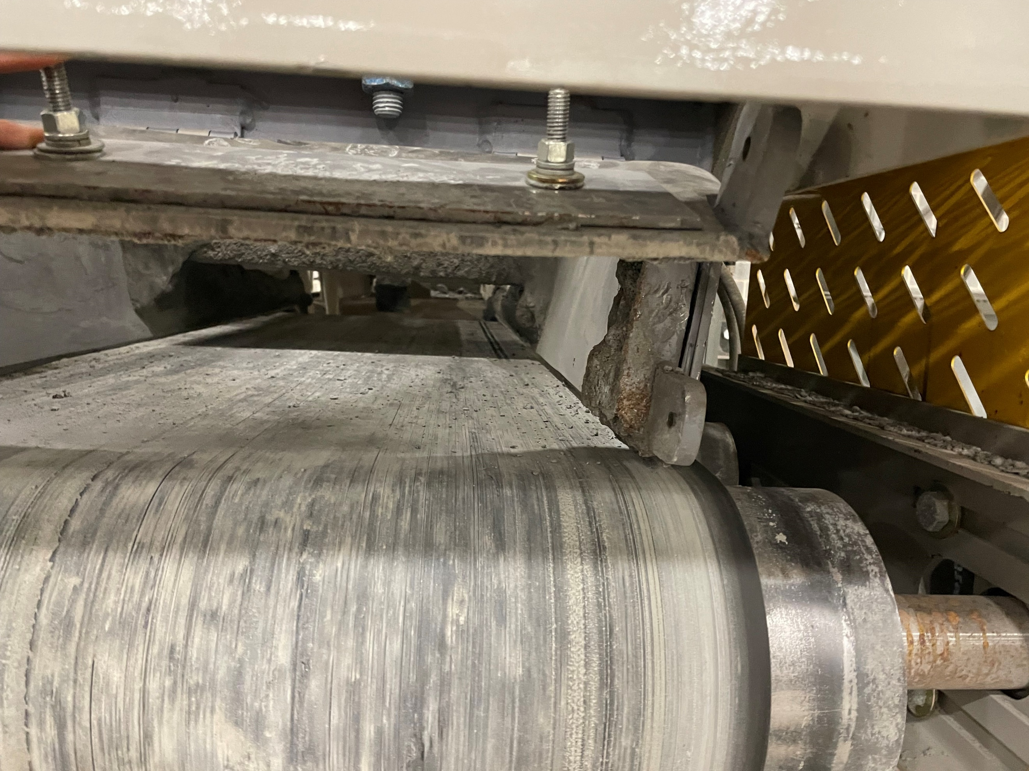
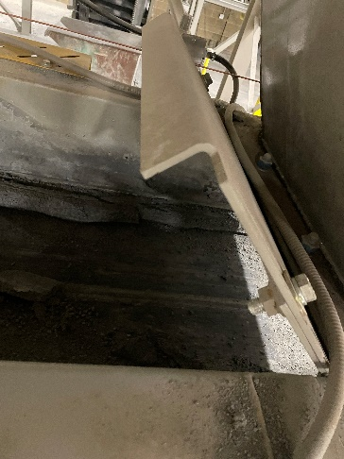
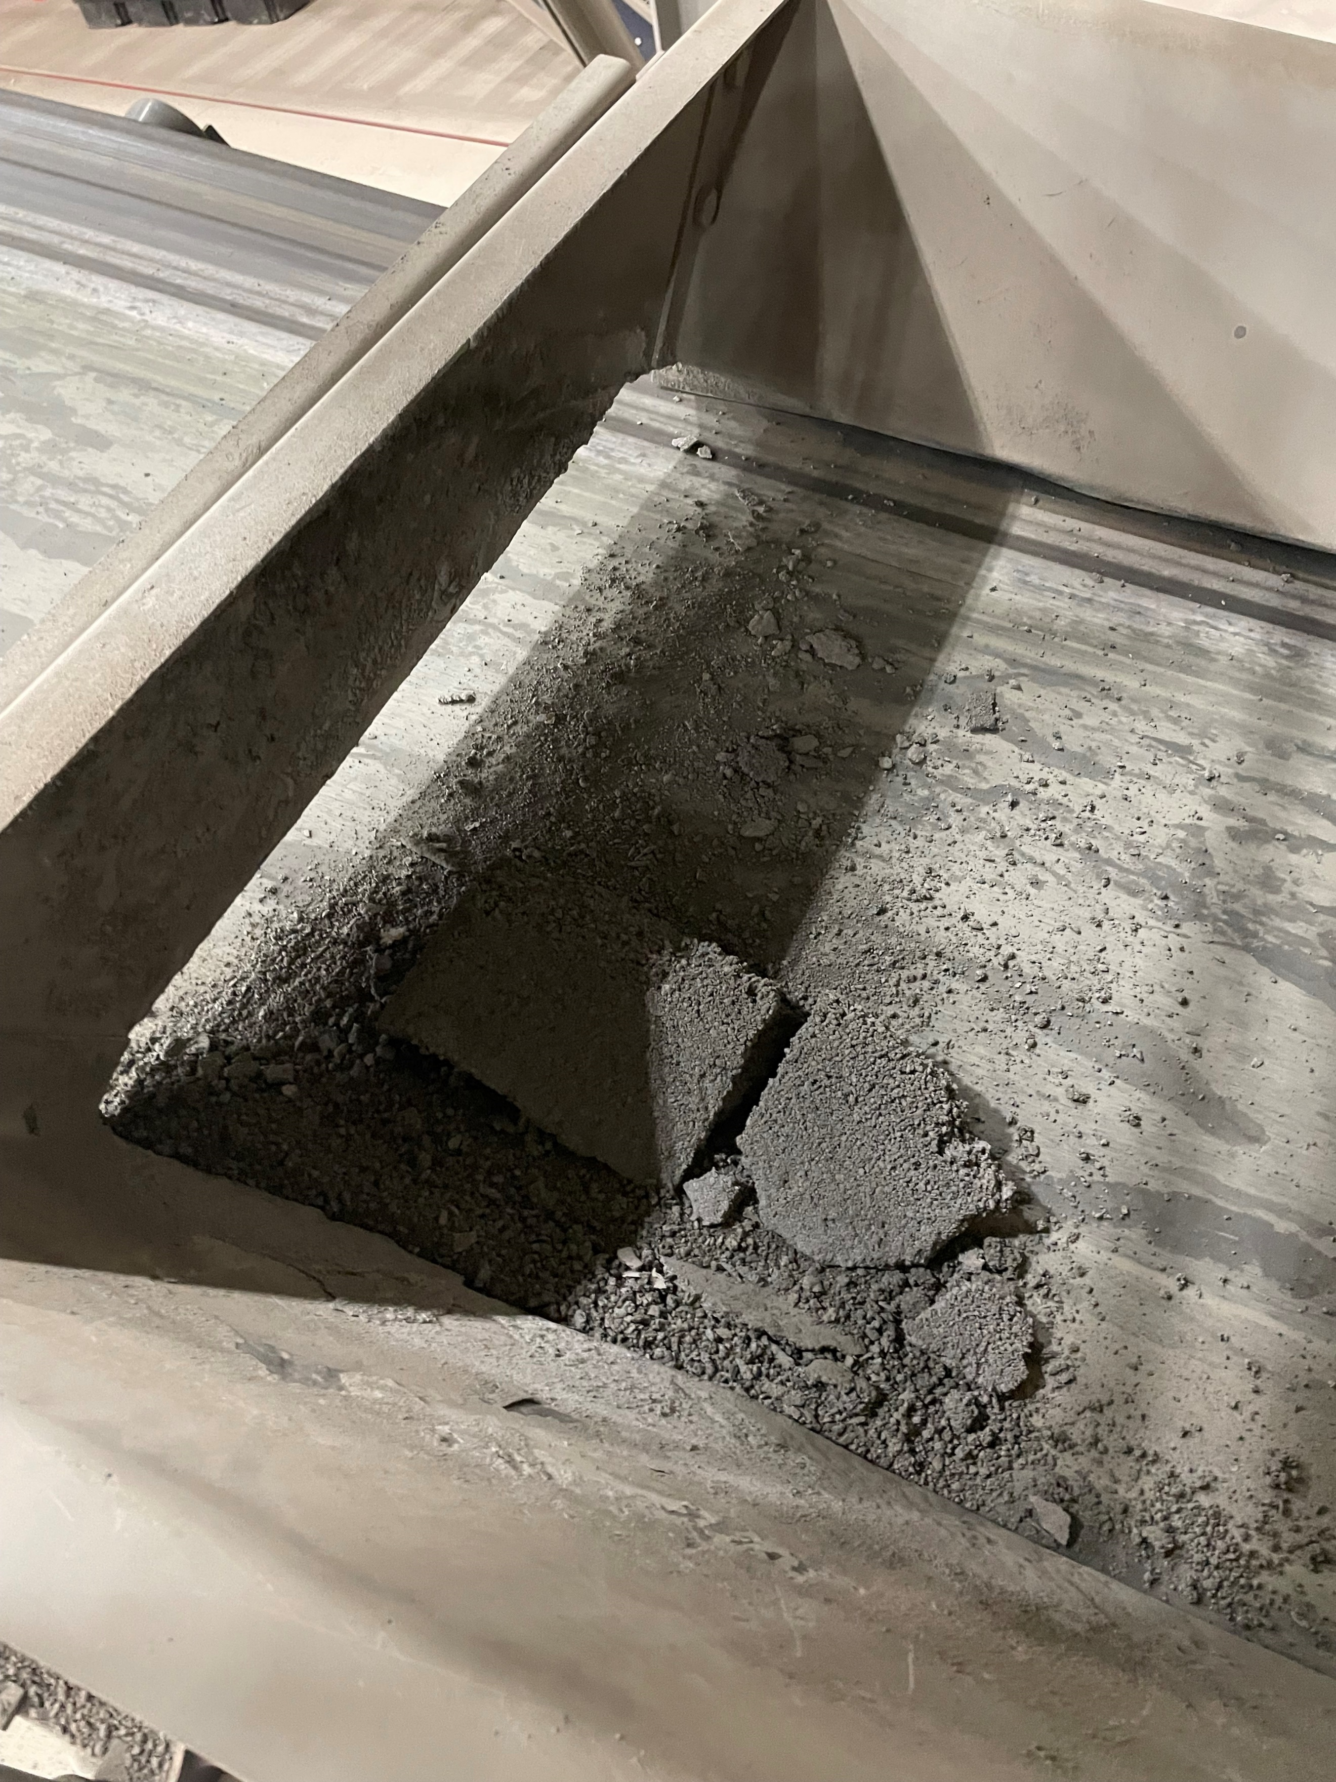
Procedure
19. Go to the mud hopper. Take out the side screw and lift open the gate flap to break apart any debris that may have stuck overnight (Figure 16A and Figure 16B). Also be sure to remove any stuck debris after the mud hopper as well (Figure 16C). Lastly, remove any debris that may be stuck to the gate in the Machine belt (Figure 16D)
Figure 16A
Figure 16B
Figure 16C
Figure 16D

Slide 19
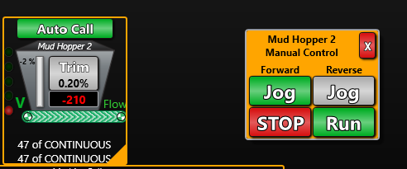
Procedure
20. Go back to the computer. Set Mud Area to manual and run the Mud Hopper 2 belt by clicking run under the reverse tab (Blue circle in Figure 17). All loose debris will now be in the waste hopper
Figure 17

Slide 20
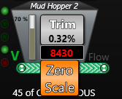
Procedure
21. Click on the value in the Mud Hopper and select “Zero Scale”. This will remove any inaccurate weight measurements on the hopper (Blue circle in Figure 18)
Figure 18

Slide 21
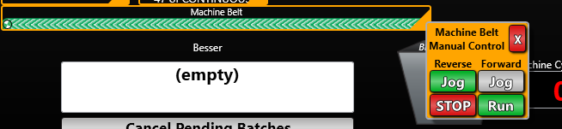
Procedure
22. For any debris that fell off the mud hopper belt, as well as the debris knocked off from Figure 3D, set the machine belt to reverse. This debris will now be on the floor (Figure 19)
Figure 19

Slide 22
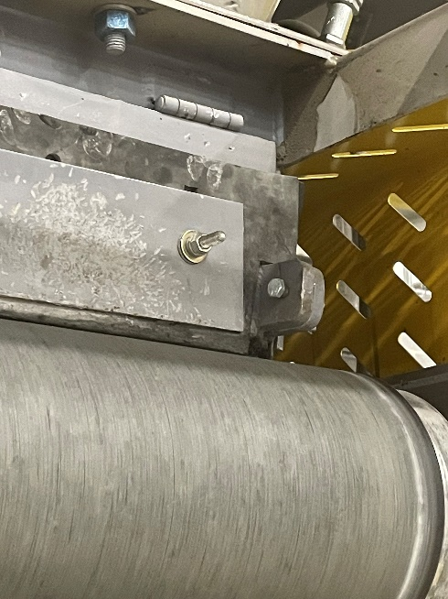
Procedure
23. Go to the Mud hopper gate and put the bolt back on (Blue circle in Figure 20). NOTE: make sure the mud hopper belt is turned off at this time.
Figure 20

Slide 23
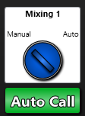
Procedure
24. Go back to the computer and set mixing to manual (Figure 21)
Figure 21

Slide 24
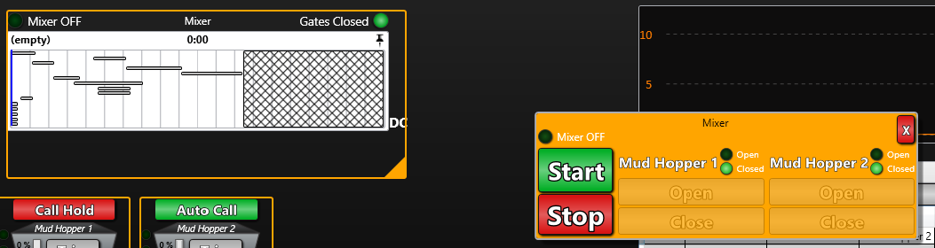
Procedure
25. Find the mixer tab, and turn it on by clicking on the orange tringle in the bottom right corner of the icon and holding the start button until you hear the mixer start-up (Blue circle in Figure 22)
Figure 22

Slide 25
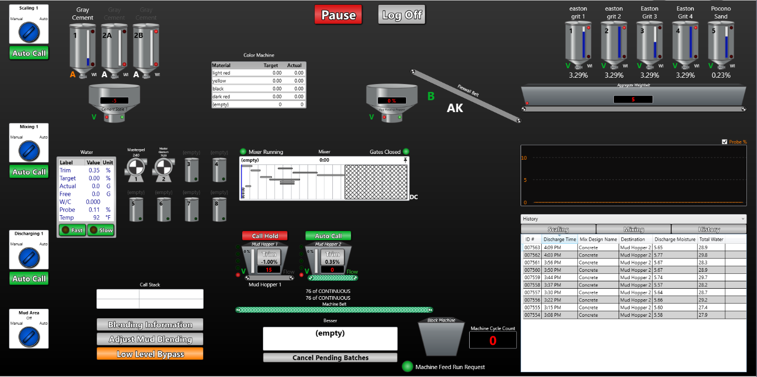
Procedure
26. Click on the button that says “Empty” at the bottom of the screen (Red circle in Figure 23)
Figure 23

Slide 26
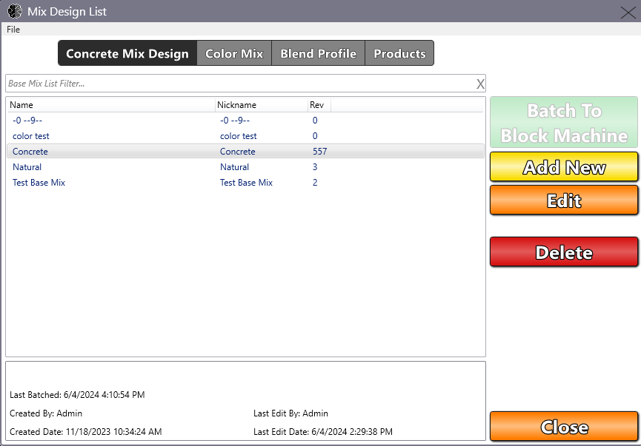
Procedure
27. Click on the “Products” Button (Blue circle in Figure 24)
Figure 24

Slide 27
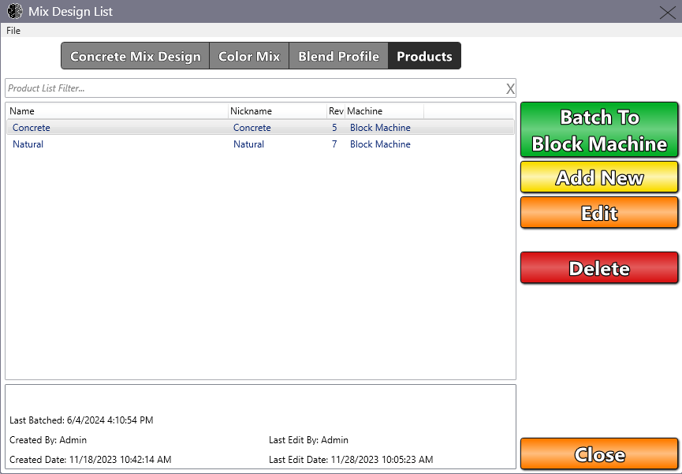
Procedure
28. At this point, the “Batch To Block Machine” button will now be available to click on (purple circle in Figure 25)
Figure 25

Slide 28
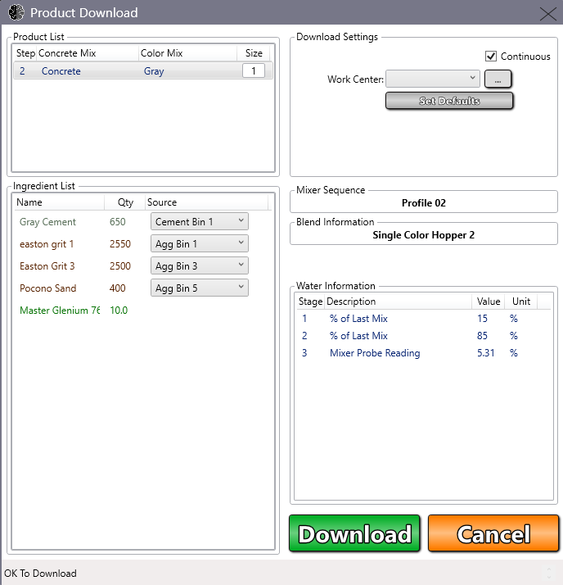
Procedure
29. Check and verify that all of the materials are what you wish to produce your first batch with (Red square in Figure 26). If it isn’t, go back and select/deselect any desired bins/silos (See SOPs Selecting/Deselecting Cement Silos and/or Selecting/Deselecting Aggregate Bins)
30. After you are satisfied with all the materials listed in the Ingredient list, Click the “Download” button (blue circle in Figure 26) and click the “Cancel” button (Yellow circle in Figure 26)
Figure 26

Slide 29
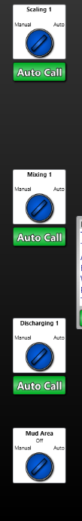
Procedure
31. Set Scaling, Mixing, Discharging, and Mud Area all to auto (Figure 27)
Figure 27

Slide 30
Procedure
32. Click on the “Pause” button (Yellow circle in Figure 28)
Figure 28

Slide 31
Procedure
33. Proceed to the HMI screen
34. Set the Control switch to the Manual position. Press and hold on the “Drop Head Position” until it stops to ensure there is no friction between the head and the mold

Slide 32
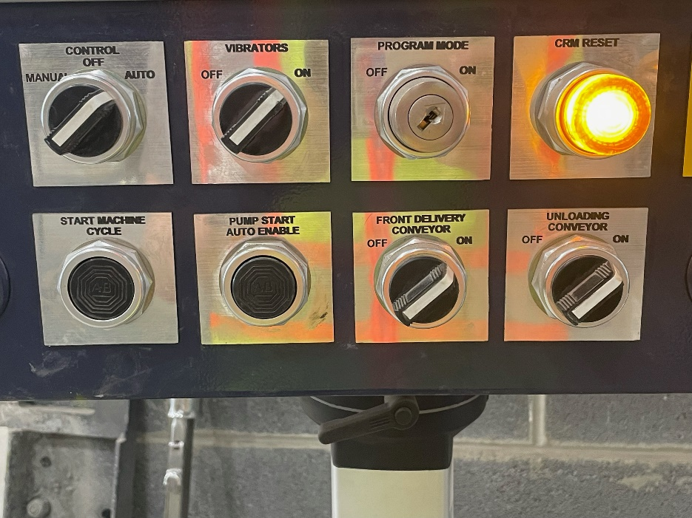
Procedure
35. Set control to auto, vibrators on, and conveyors on (Figure 29)
Figure 29 Should look like this

Slide 33
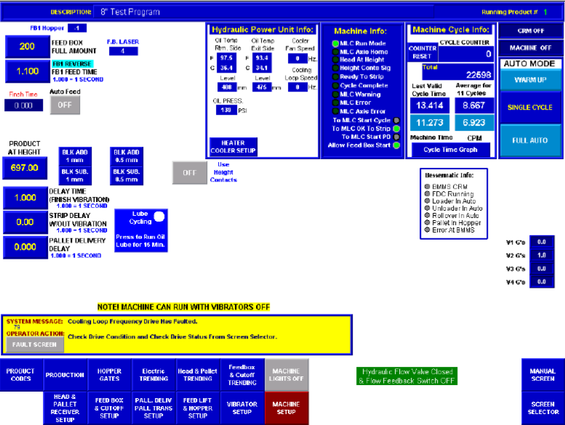
Procedure
36. Make sure you are on the “Run Screen” page of the HMI monitor. On the bottom left corner of the screen there would be a button that says “Run Screen” (Figure 30). If there is a blank space on the bottom left corner of the page, then you are in the correct page
Figure 30. Notice the empty spot on the bottom left corner is where the “Run Screen” button would be

Slide 34

Procedure
37. Press on the “Hydraulic Flow Valve” button (Figure 31)
Figure 31

Slide 35

Procedure
38. Hit “Home & Reset”. This will set the mold and receiving pallet to its proper positions (Figure 32)
Figure 32

Slide 36
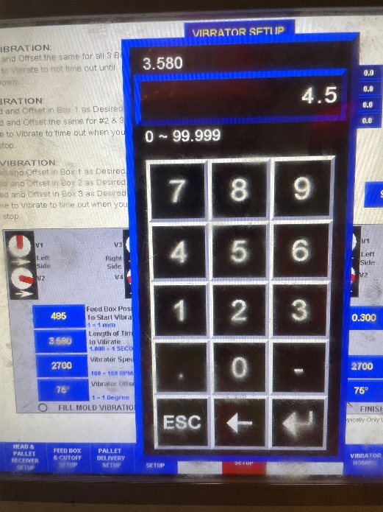
Procedure
39. Click on the “Vibration Setup” button on the bottom menu. Set the vibration time to 4.500 seconds (Figure 33)
Figure 33

Slide 37
Procedure
40. Check to make sure proper head, feedbox, pallet positions and speeds are set up in correspondence with the current mold. These can be checked through the “Head & Pallet Receiver Setup” (Figure 34A), “Feedbox & Cutoff” (Figure 34B), and “Pall. Deliv Pall. Trans Setup” (Figure 34C) buttons, all found in the bottom section of the monitor

Slide 38
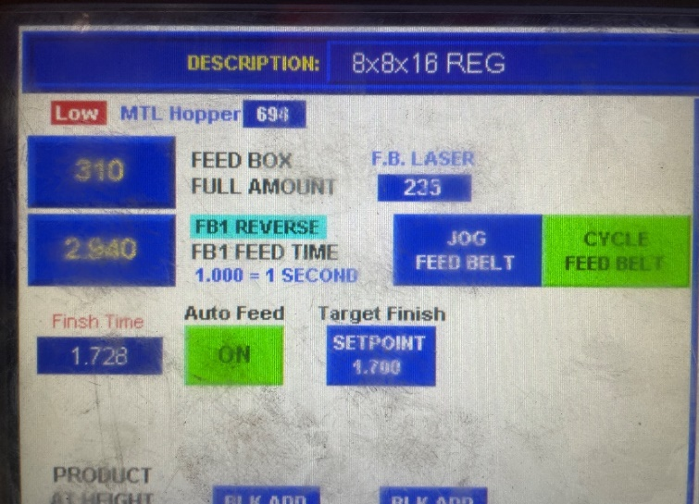
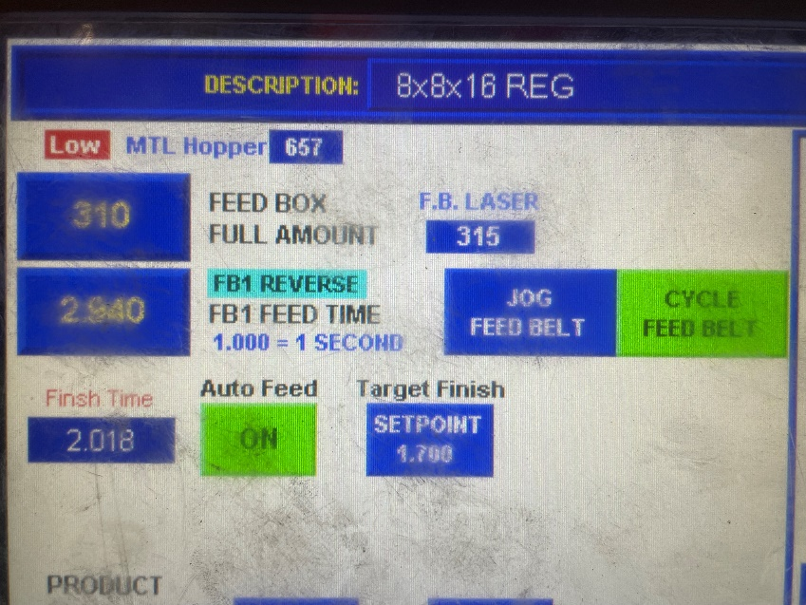
Procedure
40. Press and hold “Jog Feed Belt” until the F.B Laser value is above the “Feed Box Full Amount” value to the left of the buttons. This will give our testing pallet enough material to produce the proper output (Figure 34)
Figure 34: Insufficient
Figure 34: Sufficient

Slide 39
Procedure
41. Press the “Single Cycle” button (Red circle in Figure 35)
Figure 35

Slide 40
Procedure
42. Press the “Start Machine Cycle” button underneath the monitor (Yellow circle in Figure 36)
Figure 36

Slide 41
Procedure
44. Wait for the first pallet to come out. Check block height, perform a swipe test, and observe texture. If the pallet meets acceptable standards, press the “Full Auto” button on the “Run Screen” page (Green circle in Figure 37) and hit the “Start Machine Cycle” button again. Else, start troubleshooting the reason behind the bad pallet (SOP troubleshooting bad pallets)
Figure 37

Slide 42
Procedure
45. After about 5-10 minutes, turn on the “Auto Feed” button (red circle Figure 38). This mechanic automatically adjusts feed time based on block height. Be sure to check the pallets regularly for consistency in quality
Figure 38

